Slide 1

Gokulnath S
Final Project

Slide 2

Cartooning an Image using OpenCV

Slide 3


AGENDA
PROBLEM STATEMENT OVERVIEW
END USER SOLUTION MODELLING DEPLOYEMENT RESULTS

Slide 4
PROBLEM STATEMENT
Develop an automated system using OpenCV, a powerful computer vision library, to transform real-world photographs into cartoon-style images

Slide 5





Slide 6


END USERS
The end users of cartooning an image using OpenCV can vary widely and may include
Artists and designers Photographers Developers
Social media users
Researchers Hobbyist

Slide 7
SOLUTION
Use OpenCV to turn photos into cartoons for presentations! It converts images to grayscale, detects edges, and creates a flat, colorful outline – a cartoon effect. Save the result and add it to your slides for a visually engaging presentation.

Slide 8



MODELLING
Read the image Preprocess the image Edge detection Cartoon effect
Combine edge and color
Display or save the cartoon image

Slide 9

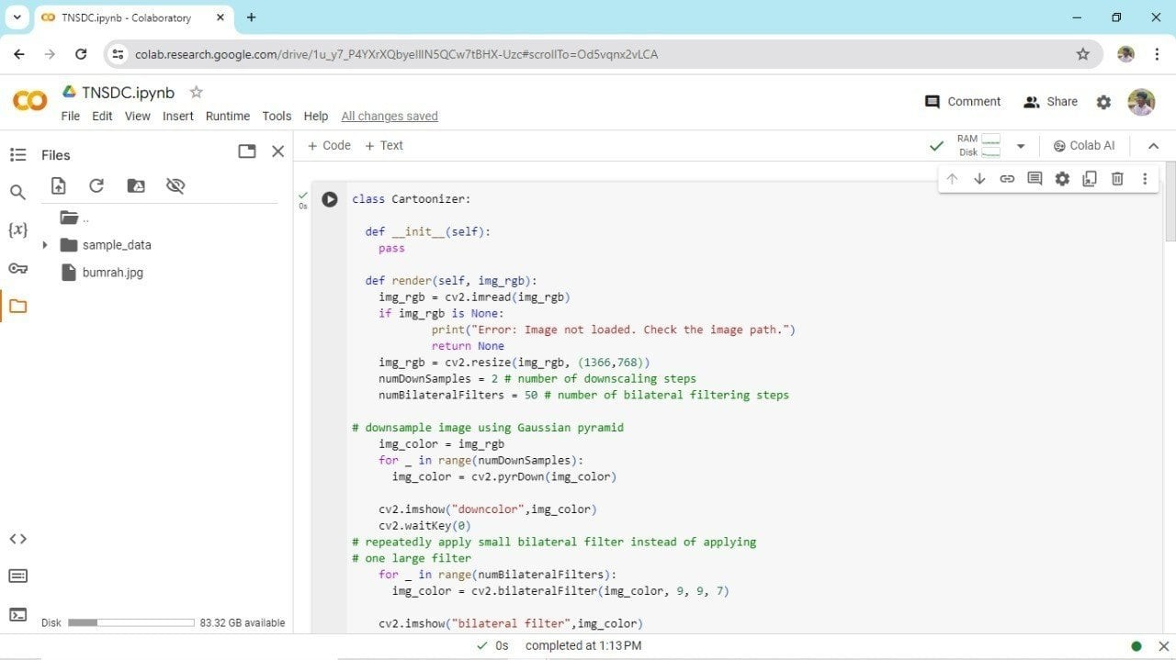
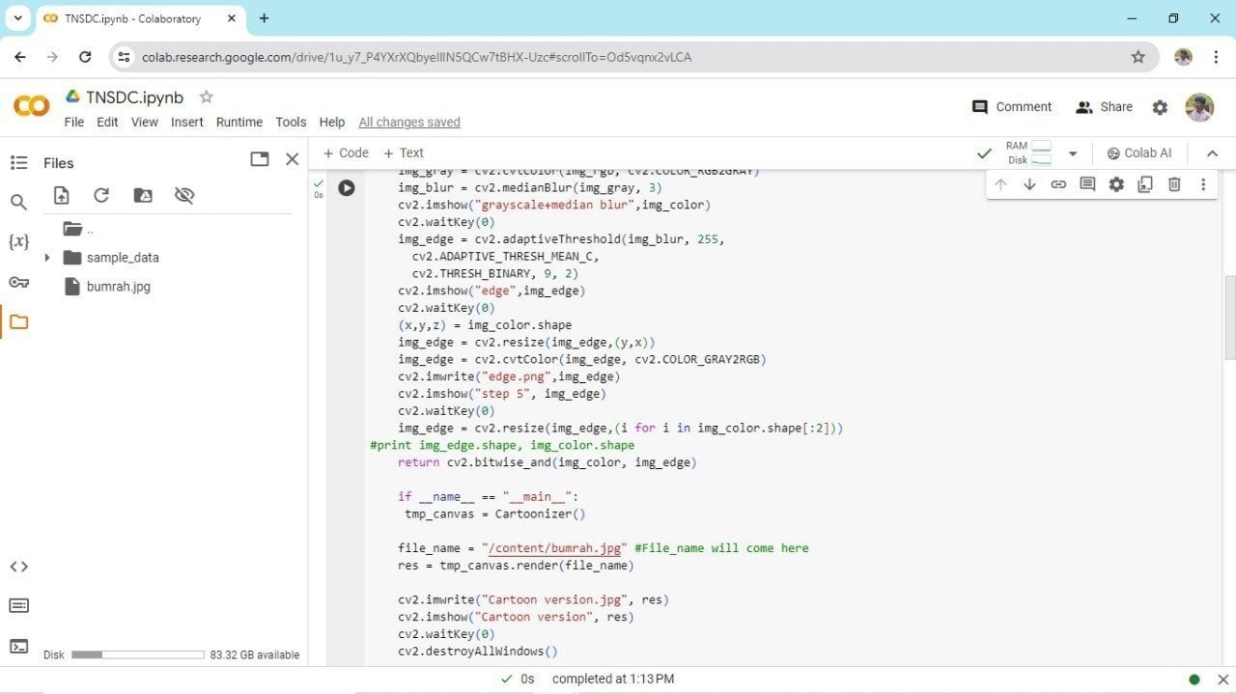

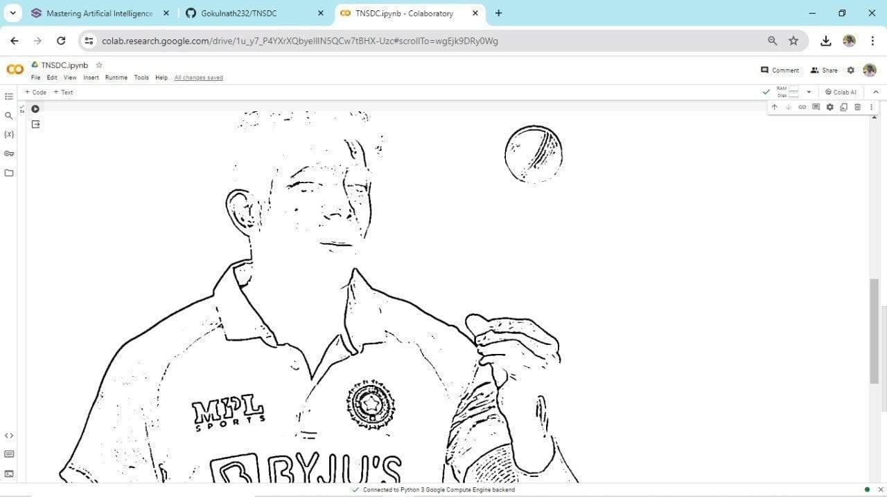
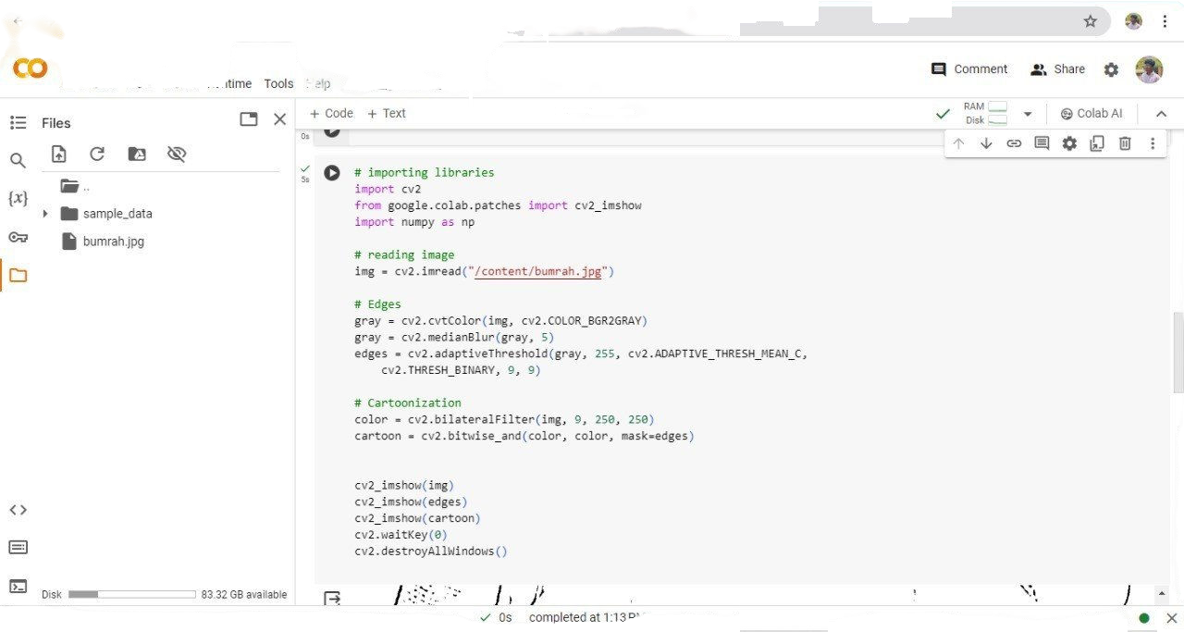
DEPLOYMENT

Slide 10




